Slide 1
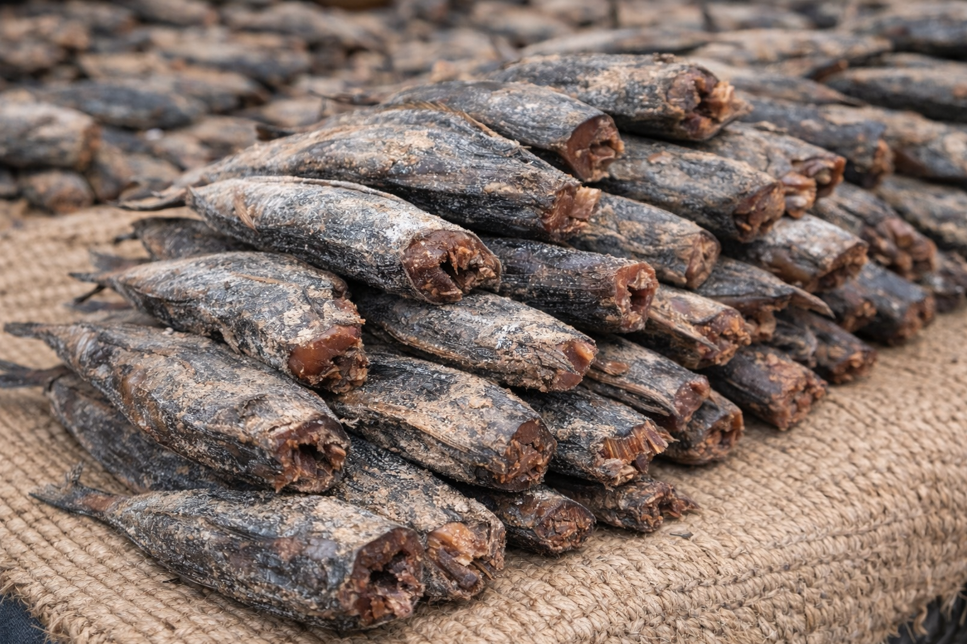



Design and Development of IoT-Based Smart
Maldive Fish Processing System
RP-26-IT-028

Slide 2
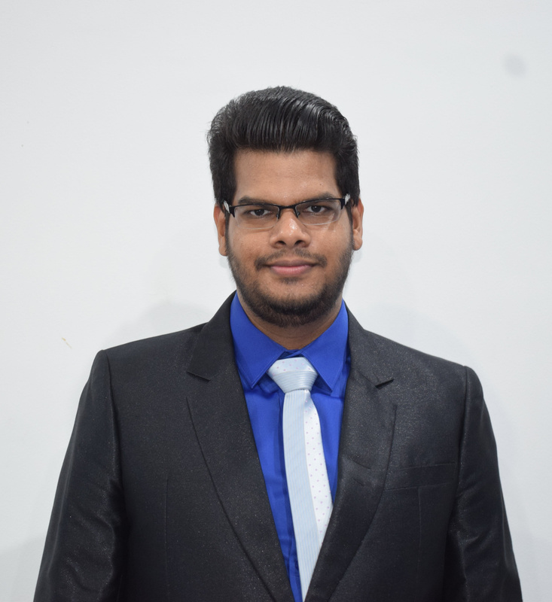
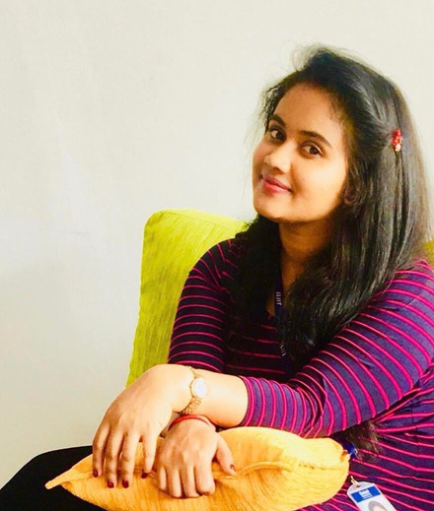



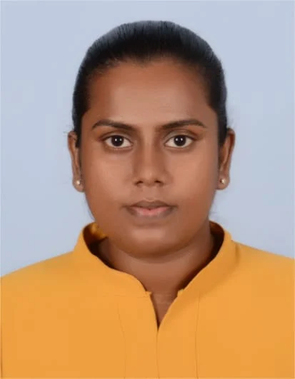
OUR TEAM MEMBERS
Mr. Supunya Swarnakantha
Ms. Dulani Jayasinghe
Supervisor
Co - Supervisor
RP- 26-IT-028

Slide 3



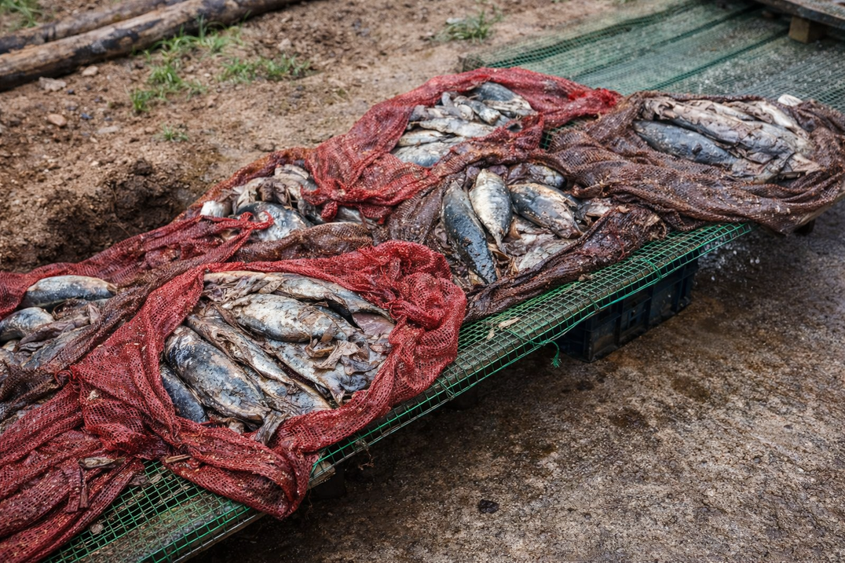
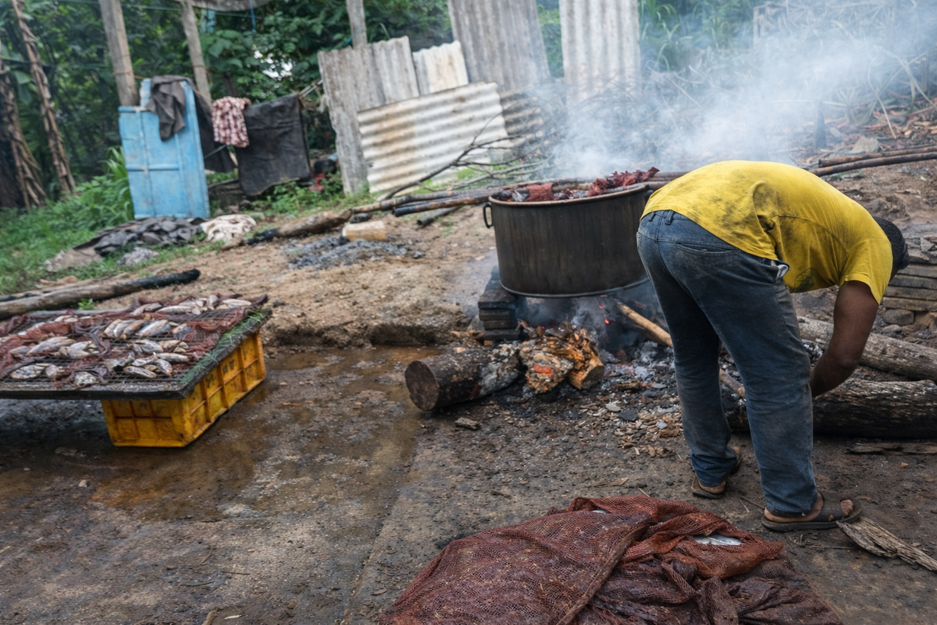
Context
Design and Development of IoT-Based Smart Maldive Fish Processing System
Problem & Motivation
Maldive fish production involves several manual quality-checking and drying processes that can affect the final product quality.
Observed Problems
  Raw fish quality checking is mainly manual
  Manual grading can cause human errors
  Fish thickness and weight are not consistently measured
  Drying conditions are difficult to monitor continuously
  Dried fish quality inspection is time-consuming
  Spoiled or low-quality fish may reach the final product
RP-26-IT-028

Slide 4
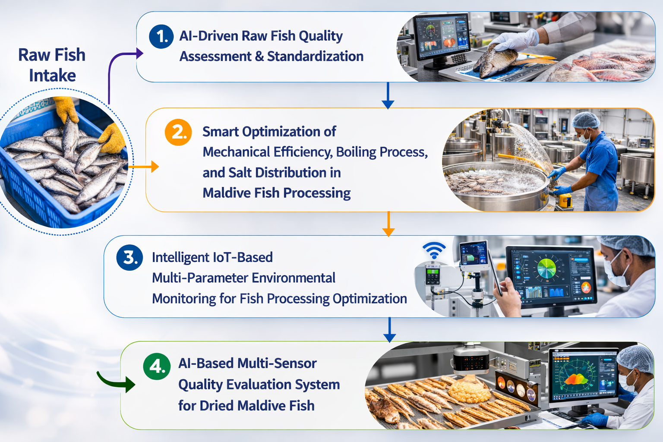
An IoT and AI-based smart system that automates fish quality assessment, boiling optimization, drying monitoring, and final dried-fish quality checking.
Design and Development of IoT-Based Smart Maldive Fish Processing System
Proposed Solution
Key Features of the Overall System
• Automated fish quality inspection
• Real-time environmental monitoring during drying
• AI-based grading and quality classification
• Centralized monitoring dashboard
Non-Functional Goals
  Easy-to-use interface
  Real-time sensor monitoring
  Accurate quality predictions
  Fast system response
RP-26-IT-028

Slide 5
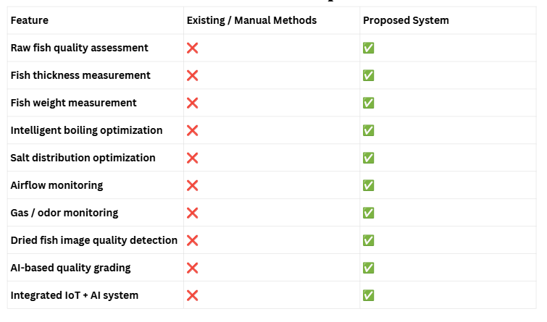
Overall Research Gap
RP-26-IT-028

Slide 6
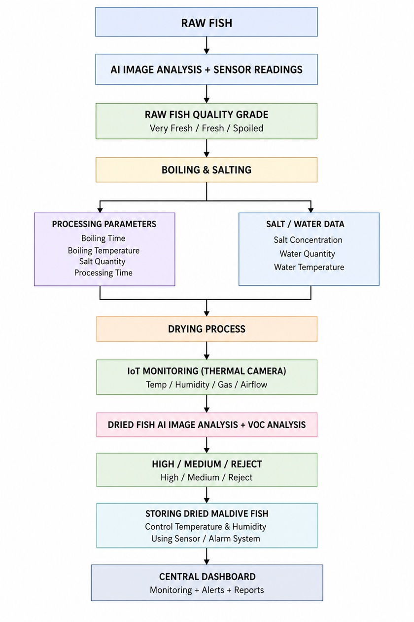
System Architecture & Integration
System Architecture Diagram

Slide 7
System Architecture & Integration
Components
  AI-Driven Raw Fish Quality Assessment & Standardization - IT22300096
  Smart Optimization of Boiling and Salt Distribution using IOT AI - IT22341686
  Intelligent IoT-Based Multi-Parameter Environmental Monitoring for Fish Processing Optimization - IT22340214
  AI-Based Multi-Sensor Quality Evaluation System for Dried Maldive Fish - IT22224934
Integration points
  ESP32 sensor communication
  Image uploads and live caption through camera
  Sensor data transmission
  AI model predictions
  Central dashboard
RP-26-IT-028

Slide 8
Commercialization
Target Users
  Maldive fish producers
  Fish processing factories
  Fish quality inspectors
  Small and medium-scale fish businesses
  Exporters
Value Proposition
  Reduces manual quality inspection
  Improves consistency
  Supports data-driven processing
  Monitors drying conditions in real time
  Detects poor-quality dried fish
  Reduces human error
Estimated Coast
Total Budget - LKR 75,000

Slide 9
THANK YOU

